Slide 1
Air Quality in bejing
Team KFCB
Team members: Lin Bai Kaitong Lu Sungmin Ko Yuqiao Feng

Slide 2
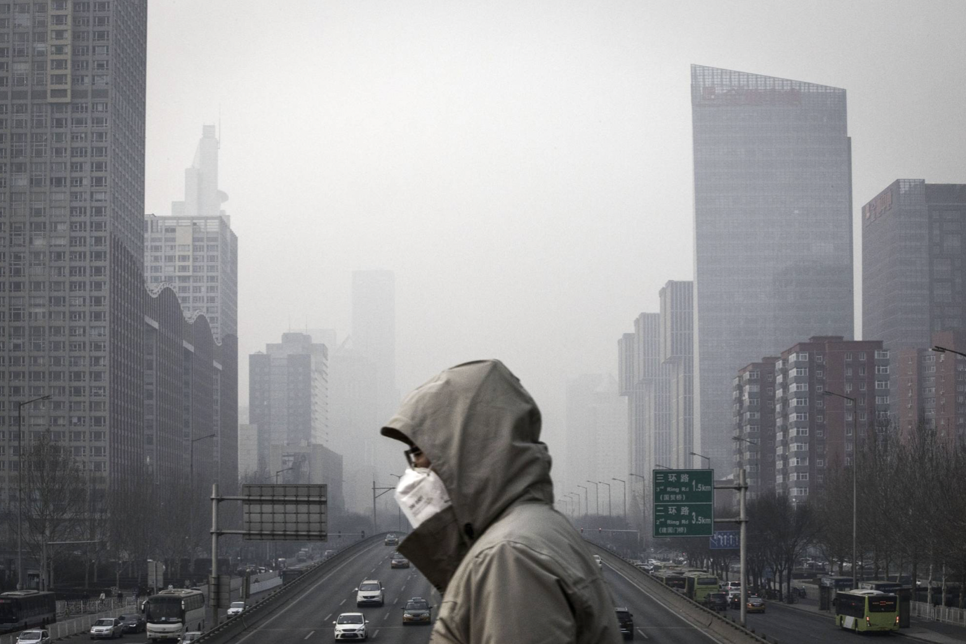
Introduction
What’s the problem?
The severe air pollution issue in Beijing, China, with rising levels of PM2.5 exceeding recommended limits.
What’s we focus on?
Understanding the patterns and trends in air quality
Identifying sources of pollution
Creating awareness about air pollution issues in Beijing.
Create a interactive app to show the air quality in Beijing

Slide 3
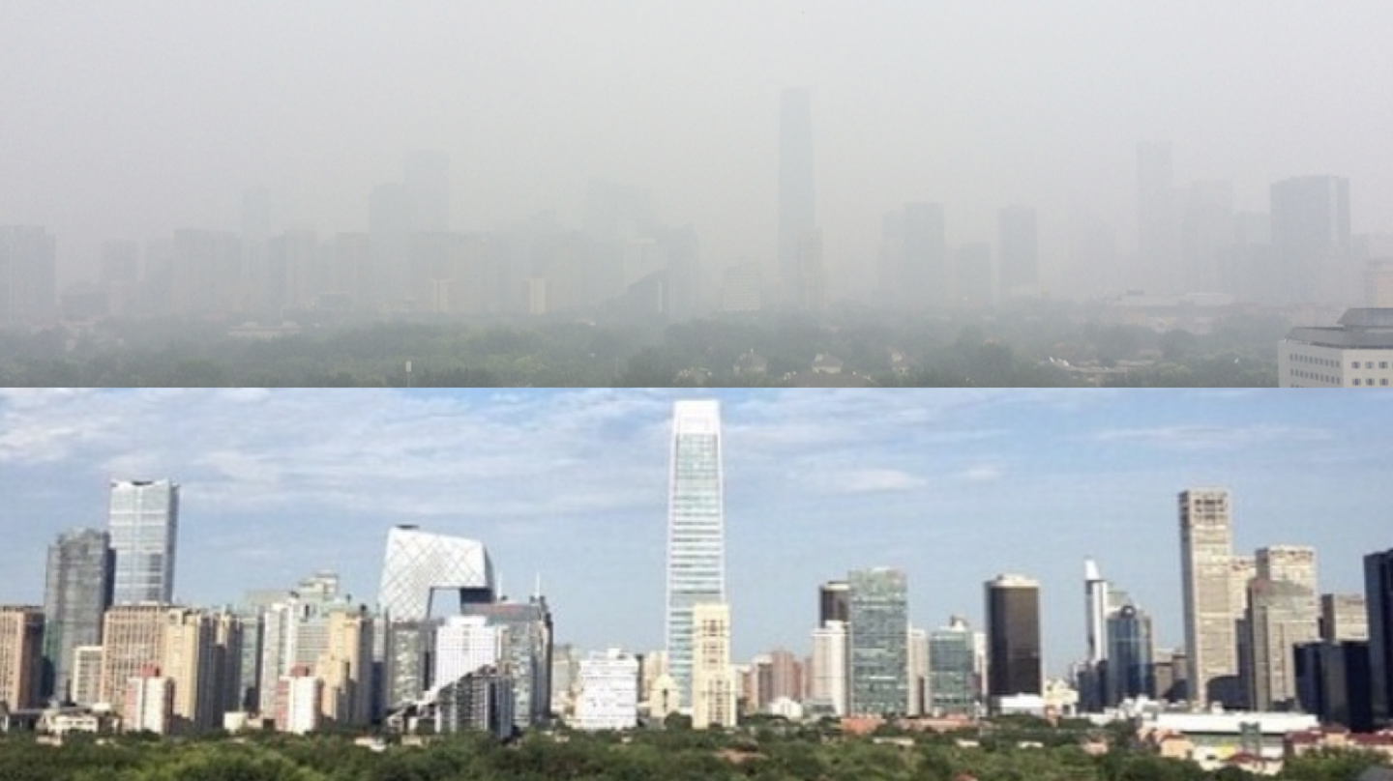
Our Goals:
Visualizing various indicators related to air pollution in Beijing.
Developing a predictive time-series model
Develop a Shiny App to help people understand air quality in Beijing
Raising awareness about air pollution issues

Slide 4
Dataset Overview
Data Source: https://archive.ics.uci.edu/ml/datasets/Beijing+Multi-Site+Air-Quality+Data#
The dataset is originally from the Guanghua School of Management at Peking University and is accessible in CSV format through the UCI Machine Learning Repository.
The dataset covers a period of four years, from March 1st, 2013 to February 28th, 2017.
The dataset provides hourly measurements of air pollutants at 12 nationally-controlled air-quality monitoring sites in Beijing, China.
The dataset contains 18 attributes that depict the varying concentrations of different pollutants per hour, as well as several meteorological variables. The attributes may include information such as pollutant concentrations (e.g., PM2.5, PM10, CO, NO2, SO2, O3), temperature, humidity, pressure, wind speed, wind direction, and weather conditions.

Slide 5
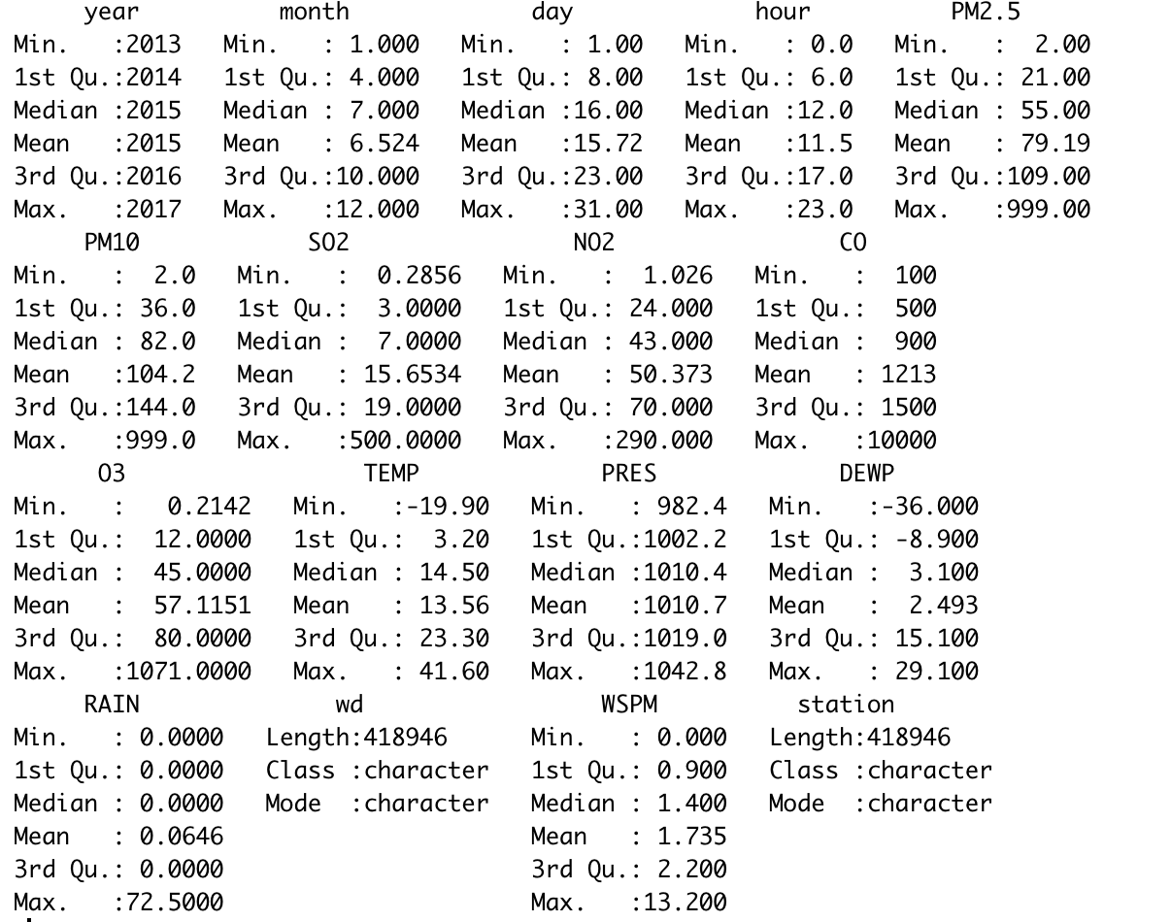
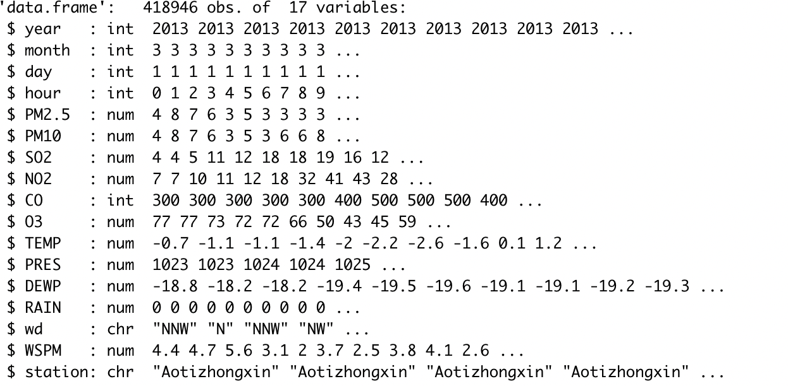
Cleaned dataset

Slide 6
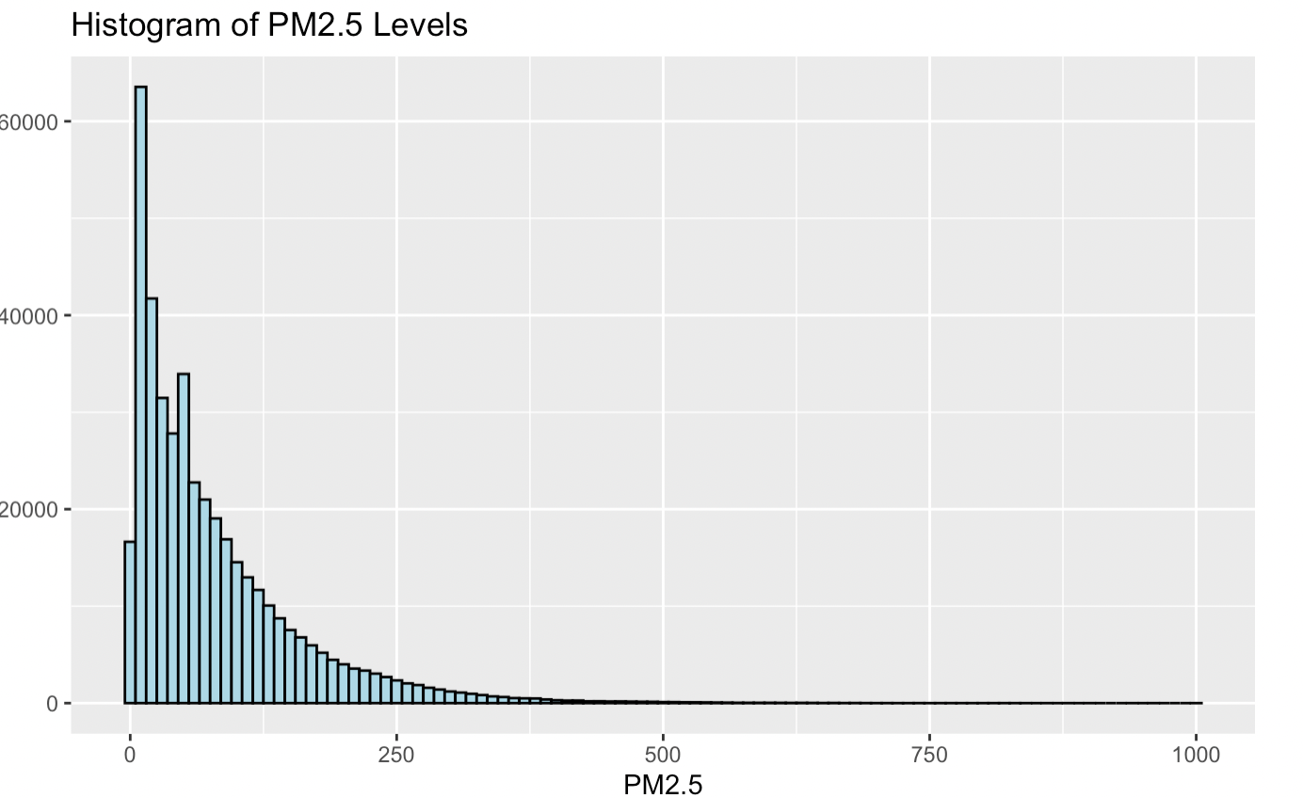
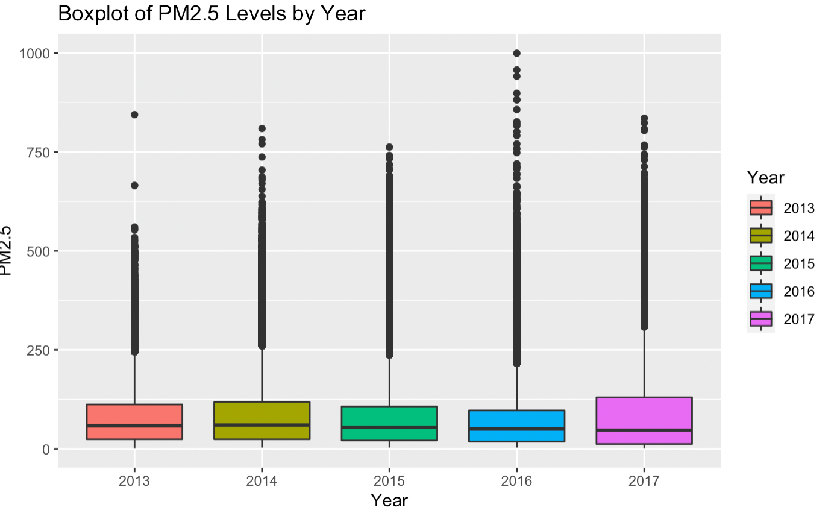
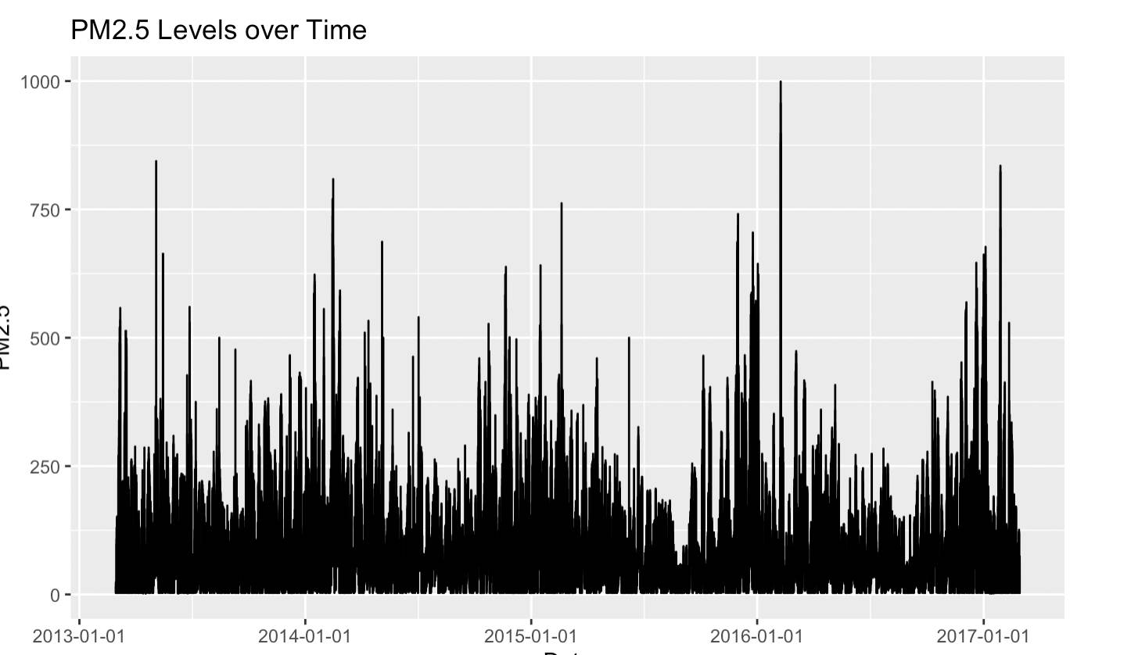
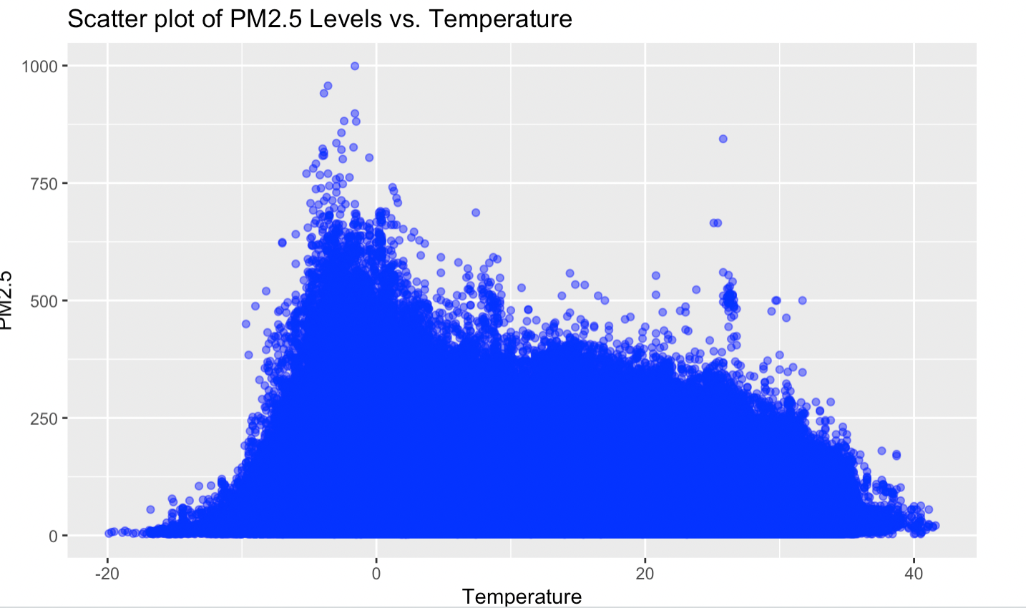

Slide 7
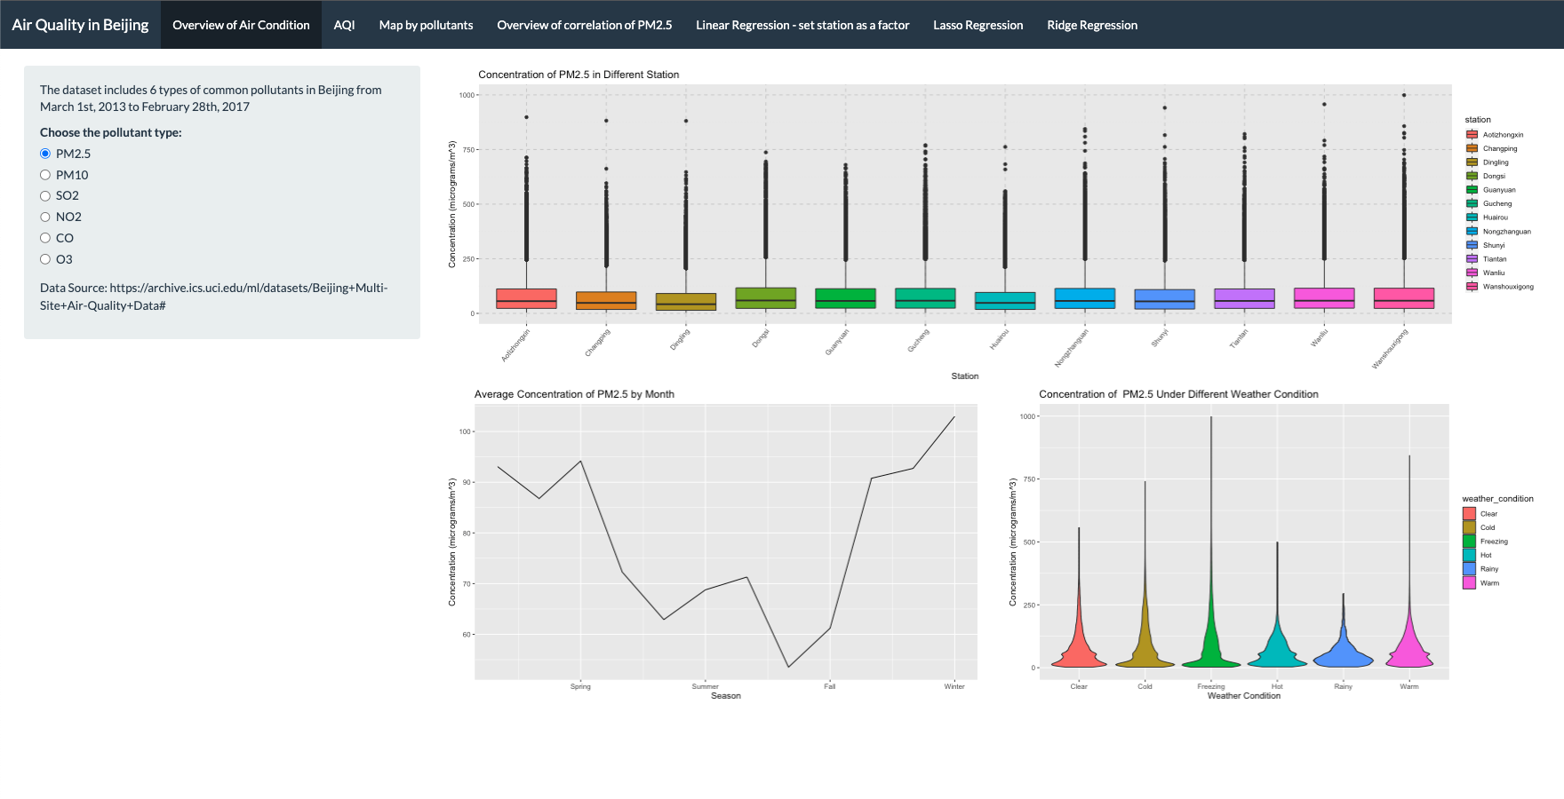
Result - Visualization

Slide 8
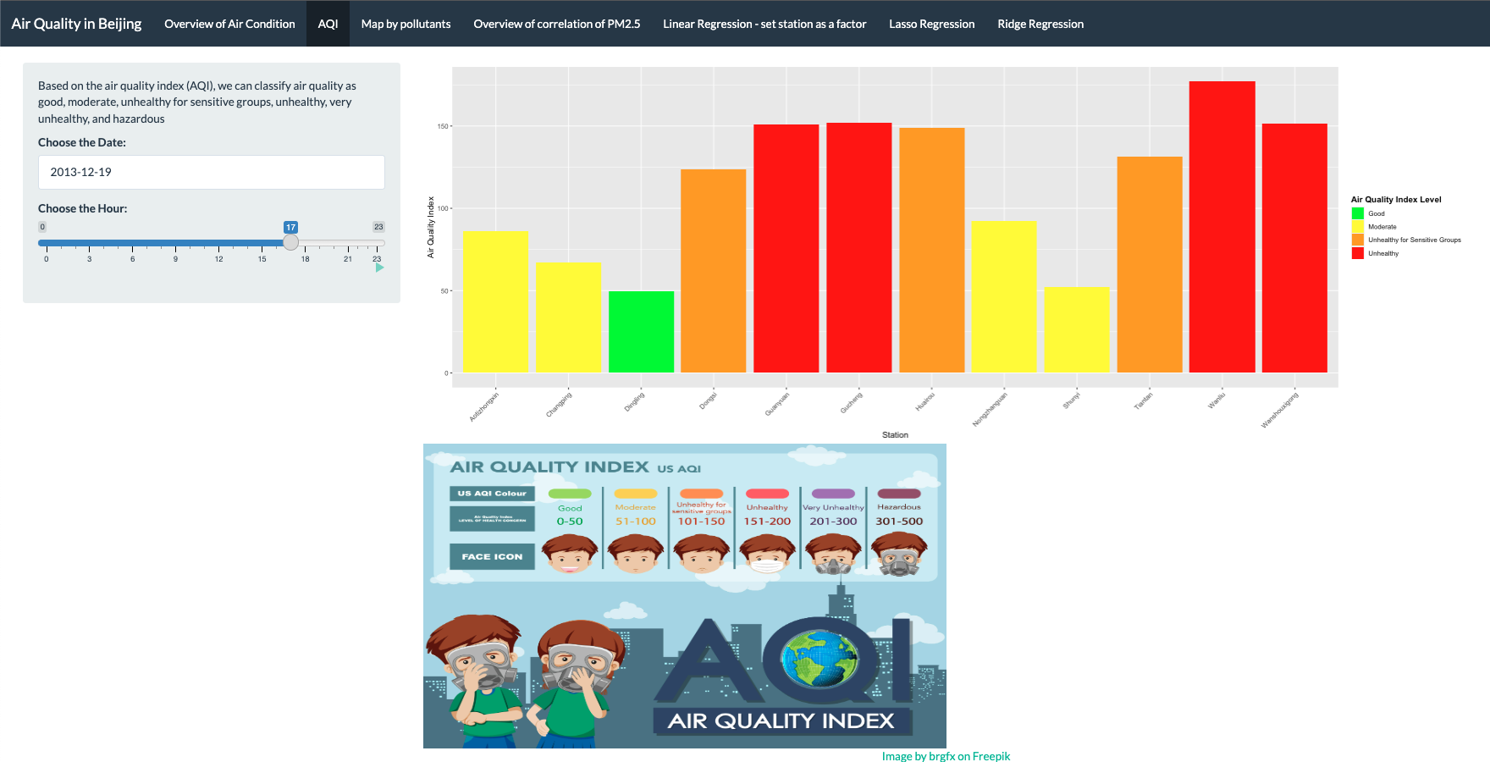
Result - Visualization

Slide 9
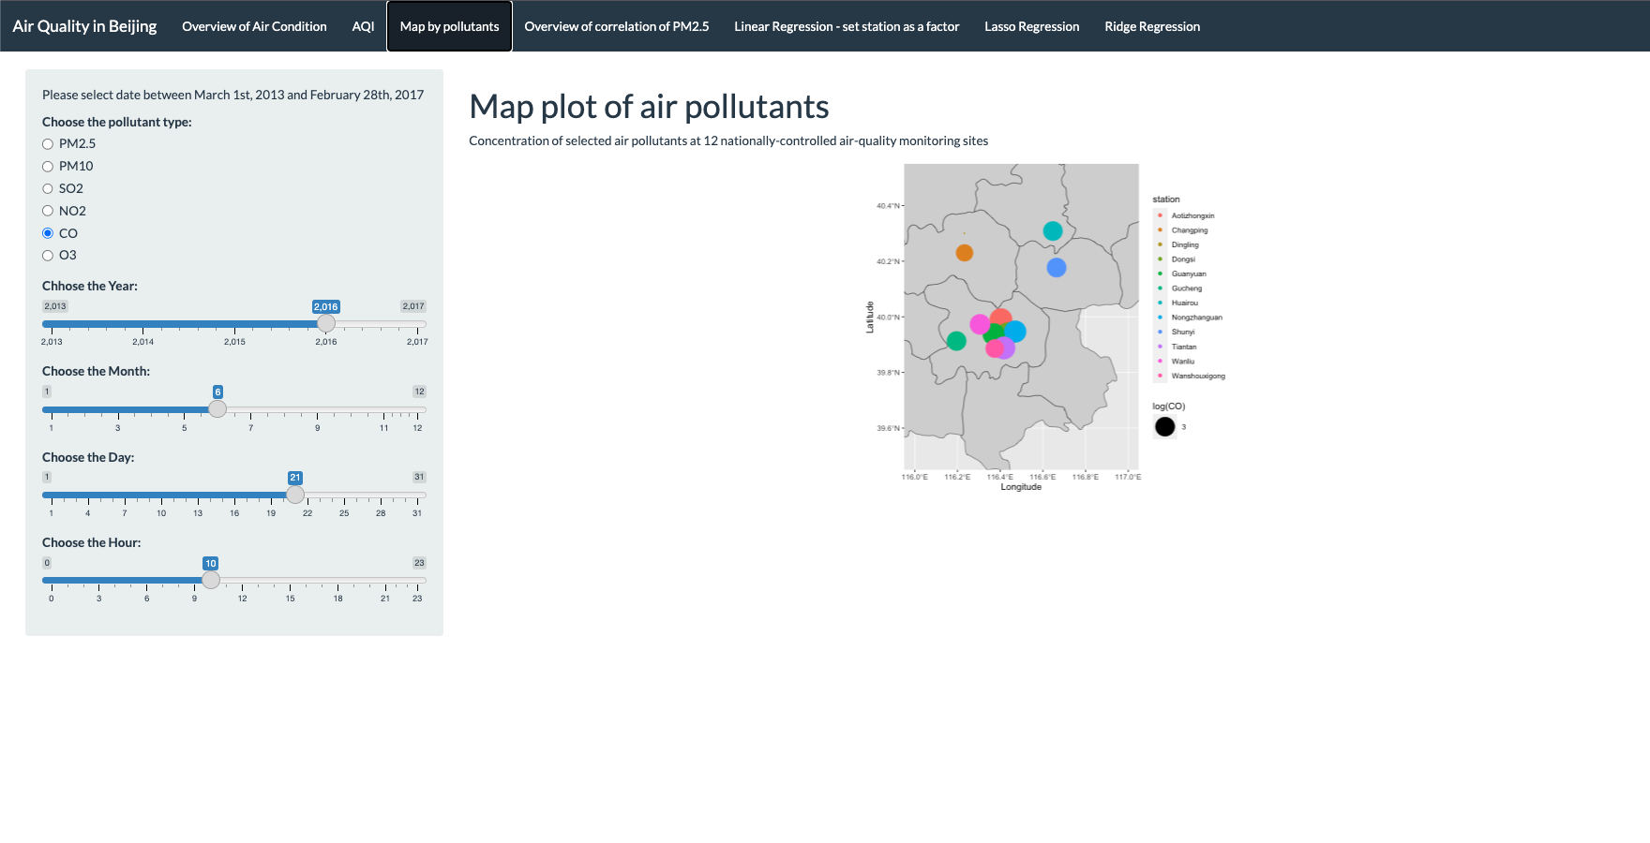
Result - Visualization

Slide 10
Modeling
The main purpose of modeling is to analyze the relationship between a dependent variable (also called the response variable or the outcome variable) and one or more independent variables (also called predictor variables or explanatory variables).
Regression analysis can help us understand how changes in the independent variables are associated with changes in the dependent variable.
There are several types of regression models, including linear regression, logistic regression, and polynomial regression, each with its own specific applications and assumptions. Overall, the main goal of regression modeling is to develop a mathematical relationship between variables that can be used to make predictions and improve our understanding of the underlying phenomena.
For Beijing Air quality dataset,we choose Ridge Regression,Linear Regression and Lasso Regression,and we can use regression to determine how other variables can affect PM2.5 and PM 10 concentrations in Beijing.
App

Slide 11
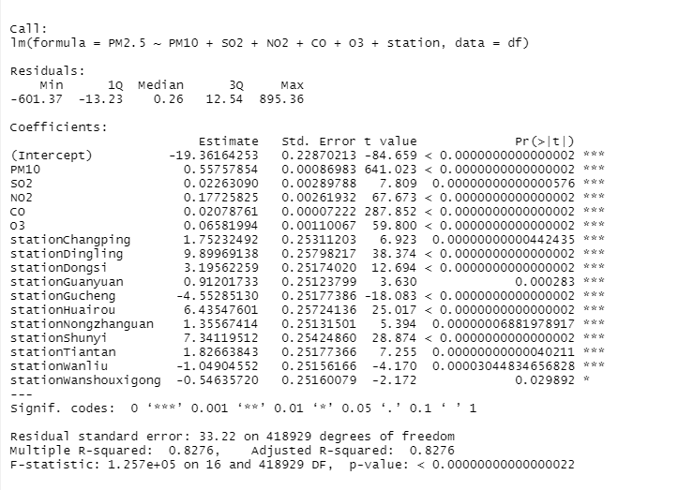
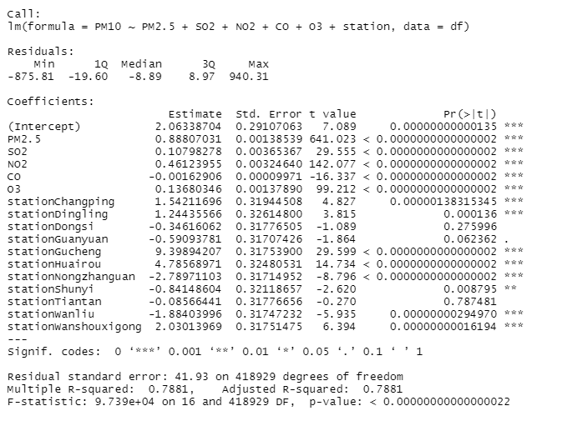
Linear regression
Set station as a factor variable and make linear regression
PM2.5 = -19.36 + .55(PM10) + 0.02(SO2) +0.17(NO2)+0.02(CO)+0.06(O3)+...
PM10 =2.0633+ 0.88(PM2.5) + 0.10(SO2) + 0.46(NO2) + -0.001(CO)+ 0.136(O3) + …

Slide 12
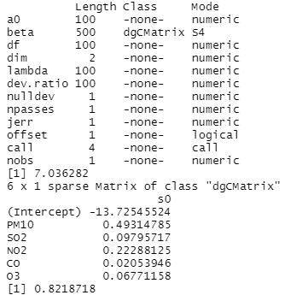
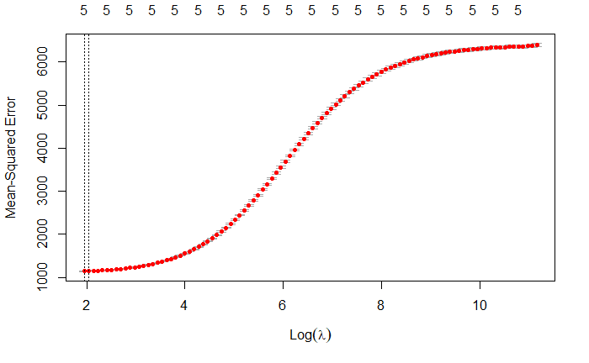
Ridge Regression
Ridge regression is a technique used in linear regression analysis to address the problem of multicollinearity (i.e., when predictor variables are highly correlated with each other) and to prevent overfitting of the model.
In traditional linear regression, the goal is to find a set of coefficients that minimize the sum of the squared errors between the predicted values and the actual values of the dependent variable. However, when there are many correlated predictor variables, the coefficients can become unstable and have high variance.
PM2.5=-13.725+0.49PM10+0.09so2+0.22NO2+0.02CO+0.067O3

Slide 13
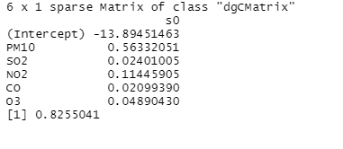
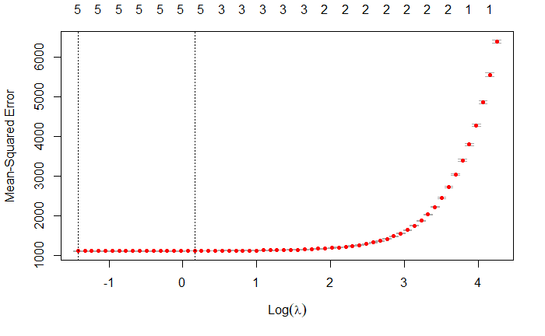
Lasso Regression
Lasso Regression, is a type of regression technique that involves adding a penalty term to the cost function in order to discourage the model from overfitting to the training data.
The penalty term in Lasso Regression is the sum of the absolute values of the model coefficients, which encourages the model to shrink the less important coefficients to zero. This can be useful in situations where there are a large number of predictors in the data, and many of them are not relevant for the outcome.
PM2.5=-13.894+0.56PM10+0.02SO2+0.11NO2+0.02CO+0.04O3

Slide 14
Shiny App
AirQualityBeijing.io
Main implementations:
Interactive data dashboards
Machine learning models
Geospatial analysis tools
Limitation
Too slow to open the app

Slide 15
Conclusion
What we have completed
Next step
Include more data
how air quality has changed over time
Train our model to improve accuracy
Health impact calculator: create a tool that estimates the health impact based on the current AQI.

Slide 16
Q & A
Thank you for listening

